Slide 1

MATHS & STATISTICs FOR DATA SCIENCE
Submitted to - submitted by-
Dr. Aashima Bangia Anamika gupta (Assistant Professor,SODS,(AAFT))
(B.sc DS,(Sem-1)

Slide 2
Topics
BASICS OF STATISTICS
DISCRETE VS CONTINIOUS
HISTOGRAM
BOX PLOTTING
FREQUENCY DISTRIBUTION
MEASURE OF CENTRAL TENDENCY
MEAN, MODE,MEDIAN
MEASURES DISPERSION
TYPE OF MEASURE OF DISPERSION
COEFFCIENT OF VARIANCE
QUARTILE DEVIATION
SKEWNESS
KURTOSIS

Slide 3
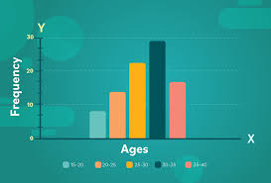
Histogram
A histogram is a graphical display of data using bars of different heights. In a histogram, each bar groups numbers into ranges. Taller bars show that more data falls in that range. A histogram displays the shape and spread of continuous sample data

Slide 4
Basics of Statistics
Statistics presents a rigorous scientific method for gaining insight into data.
For example, suppose we measure the weight of 100 patients in a study. With so many measurements, simply looking at the data fails to provide an informative account.
However statistics can give an instant overall picture of data based on graphical presentation or numerical summarization irrespective to the number of data points.
Besides data summarization, another important task of statistics is to make inference and predict relations of variables.

Slide 5
Discrete Vs continuous data
Discrete data (countable) is information that can only take certain values. These values don’t have to be whole numbers but they are fixed values – such as shoe size, number of teeth, number of kids, etc.
Discrete data includes discrete variables that are finite, numeric, countable, and non-negative integers (5, 10, 15, and so on).
Continuous data (measurable) is data that can take any value. Height, weight, temperature and length are all examples of continuous data.
Continuous data changes over time and can have different values at different time intervals like weight of a person.

Slide 6
Box Plotting
Box plots (also called box-and-whisker plots or box-whisker plots) give a good graphical image of the concentration of the data.
They also show how far the extreme values are from most of the data.
A box plot is constructed from five values: the minimum value, the first quartile, the median, the third quartile, and the maximum value.

Slide 7
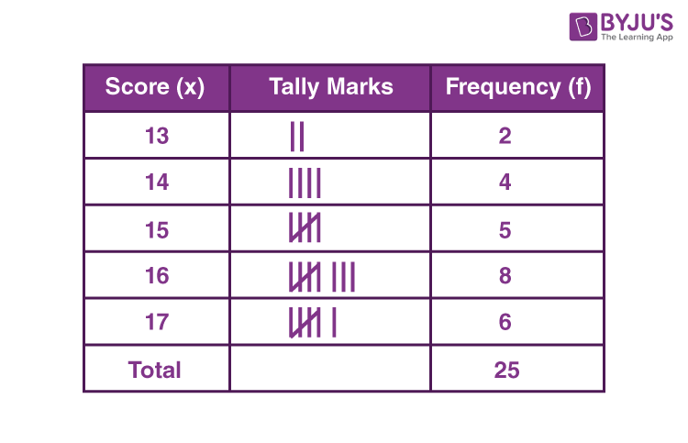
Frequency distribution
Frequency distribution refers to data classified on the basis of some variable that can be measured such as prices, weight, height, wages etc.

Slide 8
Frequency distribution
The following technical terms are important when a continuous frequency distribution is formed
Class limits: Class limits are the lowest and highest values that can be included in a class. For example take the class 51-55. The lowest value of the class is 51 and the highest value is 55. In this class there can be no value lesser than 51 or more than 55. 51 is the lower class limit and 55 is the upper class limit.
Class interval: The difference between the upper and lower limit of a class is known as class interval of that class.
Class frequency: The number of observations corresponding to a particular class is known as the frequency of that class

Slide 9
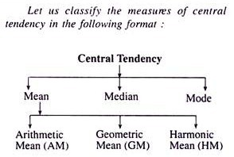
Measures of Centre Tendency
In statistics, the central tendency is the descriptive summary of a data set.
Through the single value from the dataset, it reflects the centre of the data distribution.
Moreover, it does not provide information regarding individual data from the dataset, where it gives a summary of the dataset. Generally, the central tendency of a dataset can be defined using some of the measures in statistics.

Slide 10
Mean
The mean represents the average value of the dataset.
It can be calculated as the sum of all the values in the dataset divided by the number of values. In general, it is considered as the arithmetic mean.
Some other measures of mean used to find the central tendency are as follows:
Geometric Mean (nth root of the product of n numbers)
Harmonic Mean (the reciprocal of the average of the reciprocals)
Weighted Mean (where some values contribute more than others)
It is observed that if all the values in the dataset are the same, then all geometric, arithmetic and harmonic mean values are the same. If there is variability in the data, then the mean value differs.

Slide 11
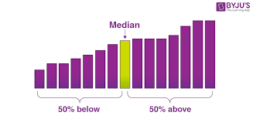
Median
Median is the middle value of the dataset in which the dataset is arranged in the ascending order or in descending order.
When the dataset contains an even number of values, then the median value of the dataset can be found by taking the mean of the middle two values.
If you have skewed distribution, the best measure of finding the central tendency is the median.

Slide 12
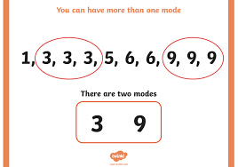
Mode
The mode represents the frequently occurring value in the dataset.
Sometimes the dataset may contain multiple modes and in some cases, it does not contain any mode at all.
If you have categorical data, the mode is the best choice to find the central tendency.

Slide 13
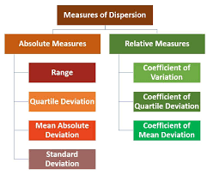
Measures of Dispersion
Dispersion is the state of getting dispersed or spread. Statistical dispersion means the extent to which a numerical data is likely to vary about an average value. In other words, dispersion helps to understand the distribution of the data.

Slide 14
Range
It is the simplest method of measurement of dispersion.
It is defined as the difference between the largest and the smallest item in a given distribution.
Range = Largest item (L) – Smallest item (S)
Interquartile Range
It is defined as the difference between the Upper Quartile and Lower Quartile of a given distribution.
Interquartile Range = Upper Quartile (Q₃)–Lower Quartile(Q₁)

Slide 15
Variance
Variance is a measure of how data points differ from the mean.
A variance is a measure of how far a set of data (numbers) are spread out from their mean (average) value.
The more the value of variance, the data is more scattered from its mean and if the value of variance is low or minimum, then it is less scattered from mean. Therefore, it is called a measure of spread of data from mean.
the formula for variance is
Var (X) = E[(X –μ) ²]
the variance is the square of standard deviation, i.e.,
Variance = (Standard deviation)²= σ²

Slide 16
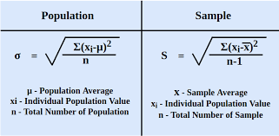
Coefficient of variance
The coefficient of variance (CV) is a relative measure of variability that indicates the size of a standard deviation in relation to its mean.
It is a standardized, unitless measure that allows you to compare variability between disparate groups and characteristics.
It is also known as the relative standard deviation (RSD).
The coefficient of variation facilitates meaningful comparisons in scenarios where absolute measures cannot.

Slide 17
Quartile Deviation
The Quartile Deviation (QD) is the product of half of the difference between the upper and lower quartiles.
Mathematically we can define as: Quartile Deviation = (Q3 – Q1) / 2
Quartile Deviation defines the absolute measure of dispersion. Whereas the relative measure corresponding to QD, is known as the coefficient of QD, which is obtained by applying the certain set of the formula: Coefficient of Quartile Deviation = (Q3 – Q1) / (Q3 + Q1)
A Coefficient of QD is used to study & compare the degree of variation in different situations.

Slide 18
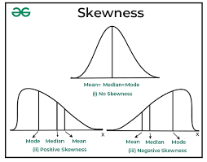
Skewness
Skewness is a measure of the degree of asymmetry of a distribution.
If the left tail (tail at small end of the distribution) is more pronounced than the right tail (tail at the large end of the distribution), the function is said to have negative skewness.
If the reverse is true, it has positive skewness. If the two are equal, it has zero skewness.

Slide 19
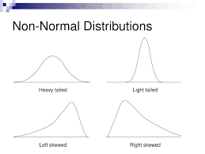
Kurtosis
Kurtosis is a measure of whether the data are heavy-tailed or light-tailed relative to a normal distribution.
That is, data sets with high kurtosis tend to have heavy tails, or outliers. Data sets with low kurtosis tend to have light tails, or lack of outliers.
Significant skewness and kurtosis clearly indicate that data are not normal.

Slide 20
THANK YOU FOR YOUYR ATTENTION AND TIME

